Slide 1
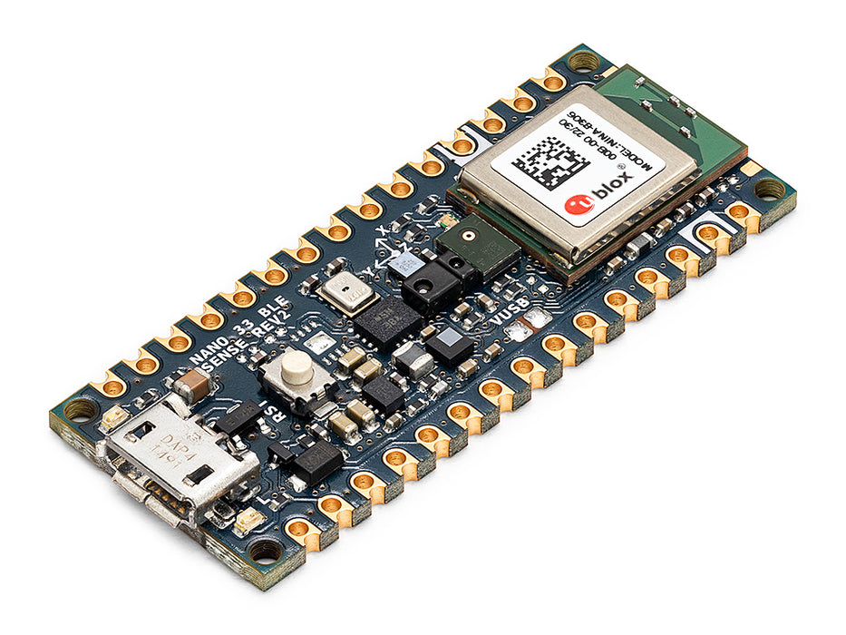
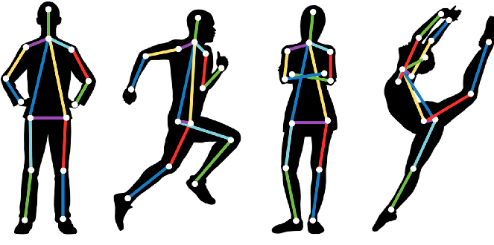
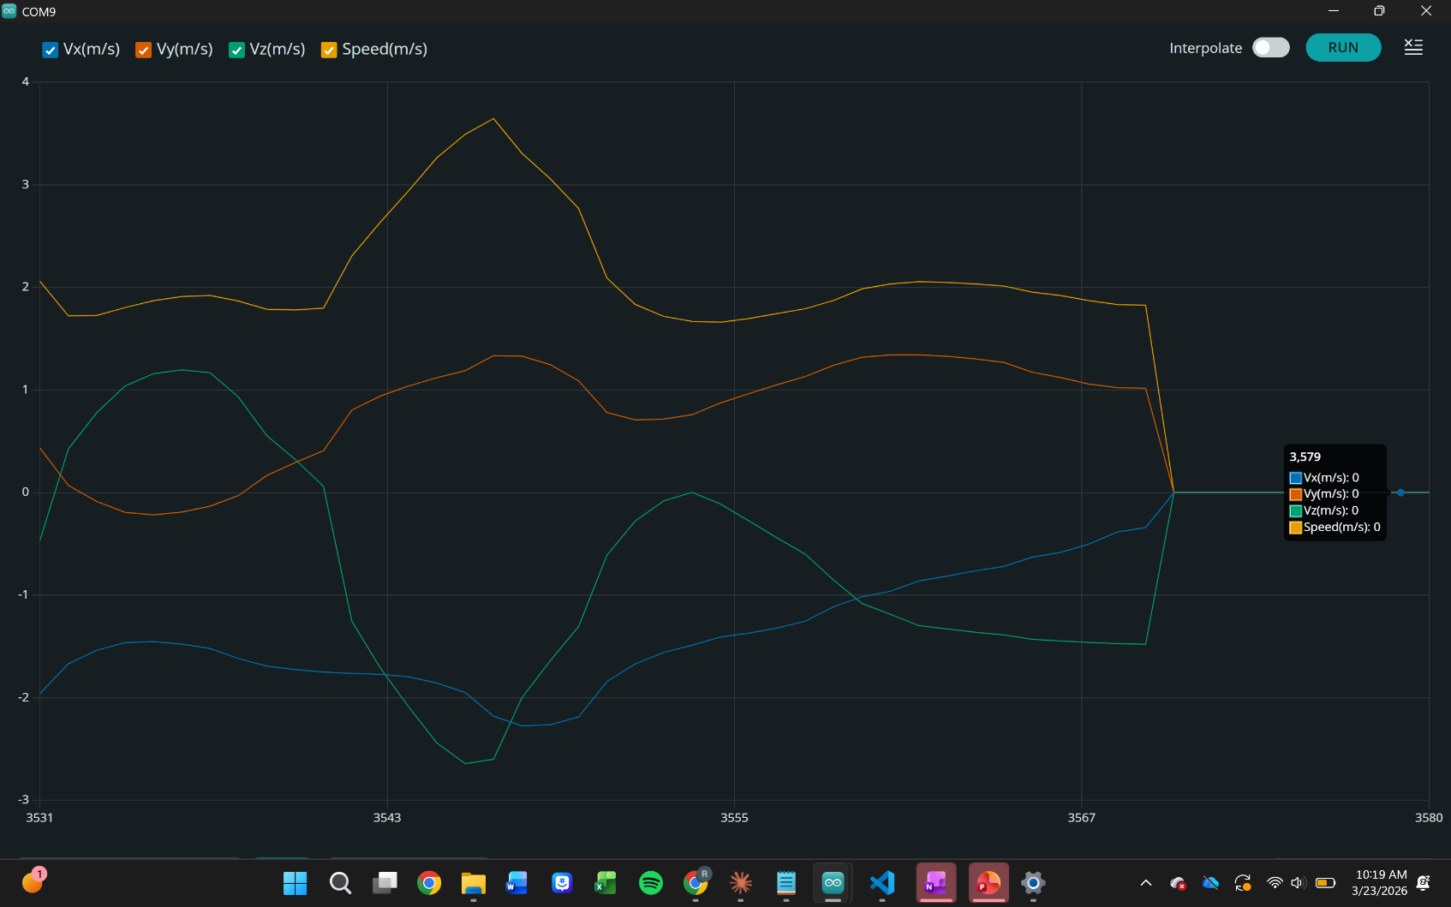
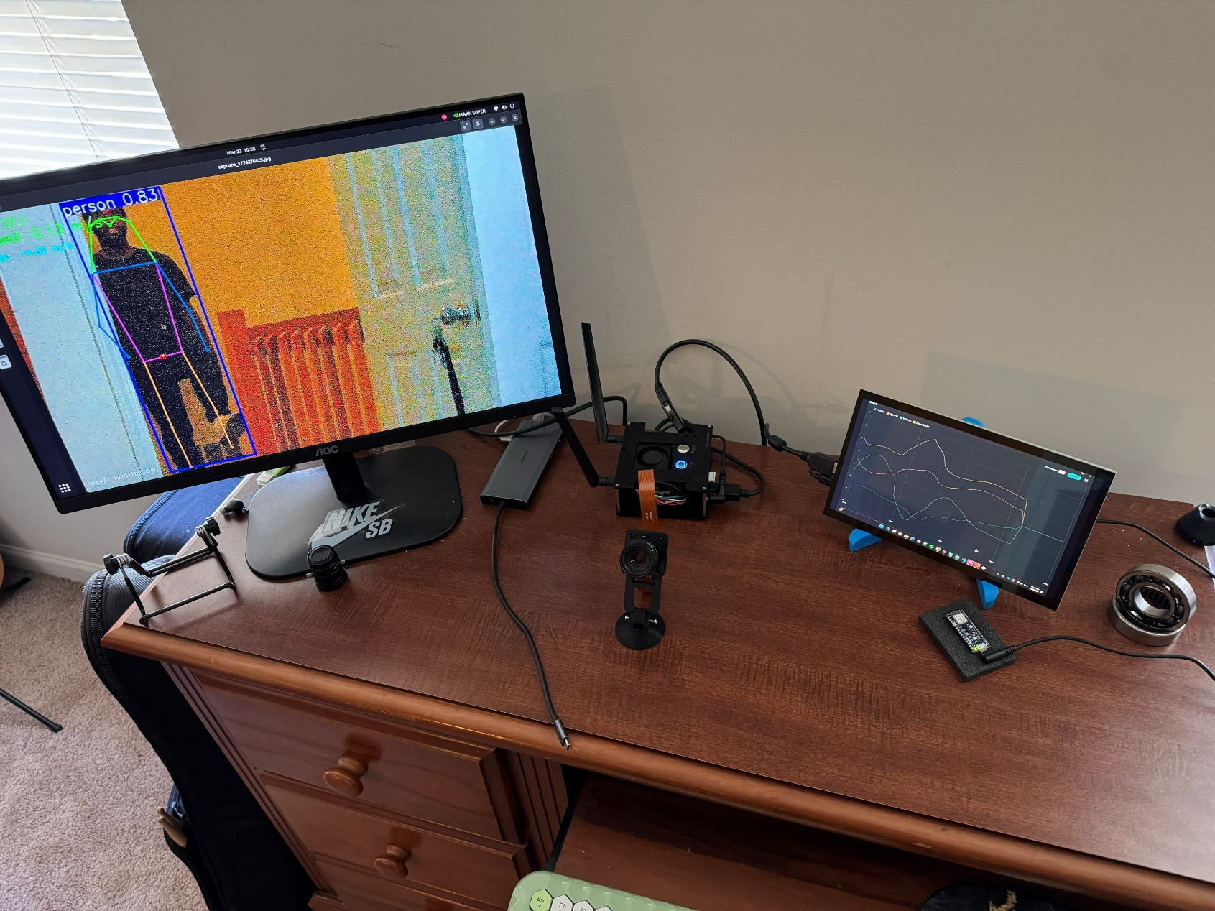
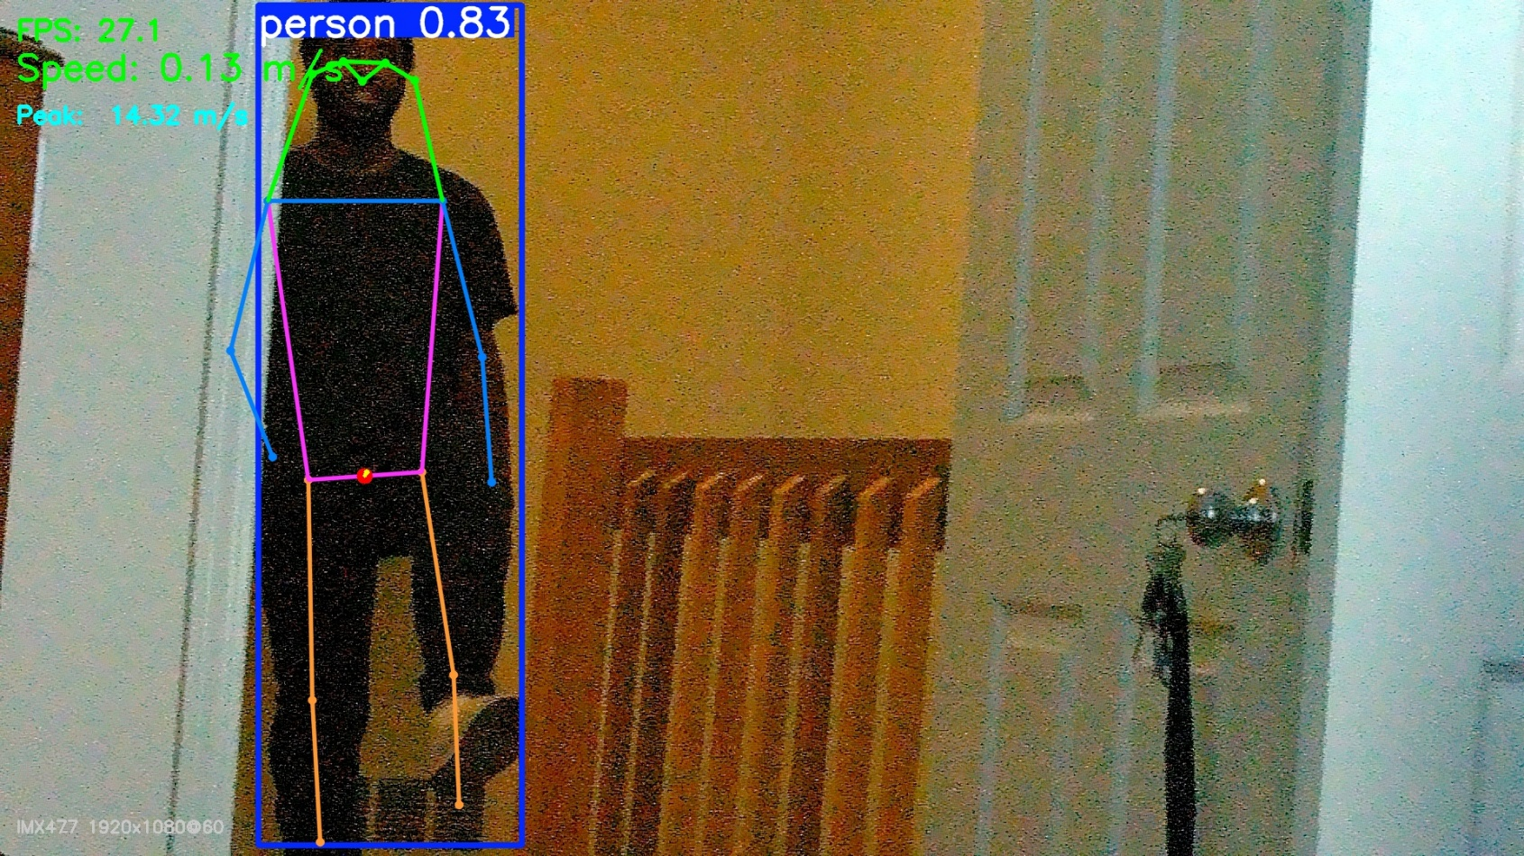
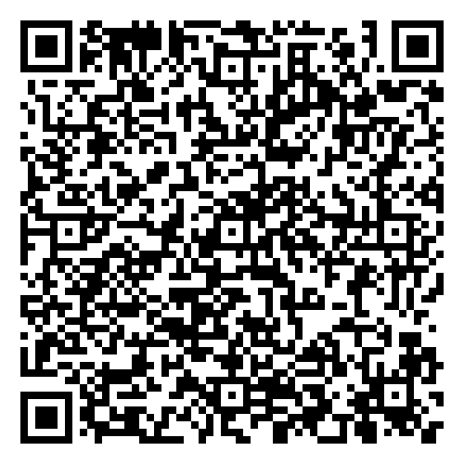


Low-Cost Velocity Estimation Using IMU Sensor Fusion and Computer Vision for Gymnastics Applications Reasun U. Allah-U-Akbar Department of Mechanical Engineering Faculty Mentor: Dr. Junghun Choi, Ph.D.
#
Background
Gymnastics performance analysis has traditionally relied on expensive optical motion capture systems (e.g., Vicon, Qualisys) requiring controlled laboratory conditions, extensive marker preparation, and specialized operators — creating significant barriers for routine training environments. Whole-body center of mass (CoM) velocity is a critical performance indicator across multiple events: vault approach speed, tumbling entry velocity, and jump mechanics are all directly derived from CoM kinematics [1].
Gymnastics also carries meaningful injury risk — 62% of injuries occur at the lower extremity, with the majority during the landing phase of skills [2] — motivating accessible tools that support technique monitoring and coach feedback without laboratory infrastructure.
Recent advances in embedded GPU computing (NVIDIA Jetson), deep learning pose estimation (YOLOv8) [1, 3], and consumer-grade MEMS inertial sensors (BMI270) present an opportunity to develop low-cost, deployable alternatives. This work implements and characterizes two parallel approaches: a Pose Estimation CV System and a Wearable IMU System, each targeting whole-body CoM velocity estimation in gymnastics contexts.
Results
Arduino Serial Plotter: Plotting IMU Velocity
Research Hypothesis
Central Question: Can low-cost embedded systems accurately estimate whole-body CoM velocity in gymnastics contexts, and how do their complementary failure modes inform a practical dual-system deployment strategy?
H1: The Pose Estimation CV System will estimate CoM velocity within ±15% of stopwatch reference measurements across walking, jogging, and sprinting conditions.
H2: The Wearable IMU System will produce comparable velocity magnitudes but will exhibit greater cumulative error over time due to double-integration of accelerometer noise, mitigated by zero-velocity update (ZUPT).
H3: Together, both systems provide sufficient biomechanical resolution to differentiate velocity profiles across gymnastics skills and apparatus types.
Dual System Setup: Pose Estimation CV System (Left Monitor) and IMU System (right LCD) running simultaneously
Pose Estimation: Segmentation plotted displaying key point confidence and speed
Discussion
Complementary System Tradeoffs:
The CV and IMU systems exhibit fundamentally complementary failure modes. The CV system degrades under occlusion, frame exit, and inverted body positions — conditions common in gymnastics — but requires no athlete-worn hardware and produces no drift over time. The IMU is completely unaffected by body orientation but accumulates velocity drift through double-integration of noisy accelerometer data, and cannot independently reconstruct spatial position or displacement.
Velocity Artifact Rejection — Three-Level Filter:
Preliminary testing revealed spurious peak velocity readings (>10 m/s) caused by erratic keypoint assignment during close-range or partial detection. Three filtering layers were implemented in response:
Level 1 — Confidence Threshold: Hip keypoint confidence >0.6 required for CoM computation; >0.75 to update peak speed record. Erratic close-range detections typically score 0.3–0.5, well below both thresholds.
Level 2 — Plausibility Clamp: Readings above 12.0 m/s are discarded as physically impossible artifacts. The history buffer is cleared on discard to prevent poisoned positions from propagating into subsequent frames. Ceiling is consistent with published peak human sprint biomechanics.
Level 3 — Peak Guard: Peak speed is updated only when both hip keypoints simultaneously exceed 0.75 confidence, ensuring the reported maximum reflects a frame of clean, complete detection.
Remaining Limitations and Future Work:
Single-camera 2D tracking cannot recover out-of-plane velocity components. Skills performed in the sagittal plane reduce bilateral hip keypoint separation, degrading the CoM proxy. Inverted positions (handstands, aerials) reduce YOLOv8 detection confidence even when the athlete is fully in frame. Proposed extensions: multi-camera 3D triangulation, gymnastics-specific pose model fine-tuning, and IMU-CV sensor fusion to combine orientation-independence with drift-free spatial tracking.
Literature Review and Preliminary Work
Markerless motion capture using deep learning has been validated against optical gold-standard systems in biomechanical contexts [3]. The YOLO family of real-time object detectors — from YOLOv1 through YOLOv8 — progressively improved detection speed and accuracy, making viable on-device inference possible [4]. Hip keypoint midpoint has been used as a CoM proxy in 2D tracking studies, with Kalman-smoothed markerless systems achieving horizontal velocity errors comparable to GPS and laser-based reference methods [4].
Raw accelerometer signals contain movement, gravity, and noise components whose separation is non-trivial during rotational motion [5]. High-pass filtering effectively removes the gravitational component but involves tradeoffs at low oscillation frequencies. Double integration of linear acceleration yields velocity but accumulates drift quadratically with time; zero-velocity update (ZUPT) is the primary mitigation strategy in body-worn IMU systems [5].
No published work has directly compared a markerless CV approach and a wearable IMU approach for CoM velocity estimation in artistic gymnastics on embedded hardware. Prior embedded CV systems have not been validated against reference measurements on-apparatus, and no gymnastics-specific IMU-CV fusion pipeline exists in the literature.
Methodology & Approach
Pose Estimation CV System
Hardware: NVIDIA Jetson Orin Nano 8GB (JetPack 6.2.1, CUDA 12.6) + Arducam IMX477 12.3MP CSI camera, Computar 12mm f/1.4 C-mount lens, 1920×1080 @ 60fps
Inference: YOLOv8n-pose, on-device GPU; ~24fps effective; 41.5ms mean latency. CoM estimated as bilateral hip keypoint midpoint (keypoint indices 11 and 12).
Velocity: Least-squares regression over a 5-frame sliding window; pixel displacement converted to m/s via calibrated PIXELS_PER_METER constant.
Quality Filter (3 levels):
Key point confidence > 0.6 for CoM computation
Physiological plausibility clamp at 12.0 m/s; poisoned history buffer cleared on discard
Peak speed updated only when both hips simultaneously exceed 0.75 confidence
Wearable IMU System
Hardware: Arduino Nano 33 BLE Rev2, BMI270 6-axis IMU (±16g range, ~104Hz). Mounted at sternum center.
Signal Processing: High-pass filter (α = 0.95) removes gravity and low-frequency drift [5]. Trapezoidal integration yields velocity. ZUPT resets velocity when |a| < 2.0 m/s² for 20 consecutive samples (~200ms).
Logging: 100Hz CSV via serial — timestamp, ax, ay, az, vx, vy, vz, speed, peak. Trial start/stop controlled via serial command.
Validation Protocol
• 5-meter straight-line reference trials (walk / jog / sprint) timed by stopwatch. Both systems run simultaneously. Target accuracy: ±15% of reference. 5 repetitions per speed condition.
Findings and Importance
Full real-time pose estimation pipeline deployed on embedded hardware (Jetson Orin Nano) with no external compute required — total hardware BOM under $500, making biomechanical velocity tracking accessible outside the laboratory environment [4].
Dual-system architecture reveals complementary failure modes between vision and inertial sensing, providing the rationale and design groundwork for future IMU-CV sensor fusion.
Three-level velocity quality filter is sport-agnostic and replicable — applicable to any markerless computer vision velocity tracking application regardless of sport or apparatus.
References / Acknowledgments
[1] Huynh, Q. D., et al., 2023, "AI Enhanced Resistance Training: Segmentation and Velocity Tracking Using Computer Vision," Proc. 2023 International Conference on Digital Image Computing: Techniques and Applications (DICTA), pp. 494–500, doi:10.1109/dicta60407.2023.00074\
[2] Harringe, M. L., Renström, P., and Werner, S., 2007, "Injury Incidence, Mechanism and Diagnosis in Top-Level Teamgym: A Prospective Study Conducted Over One Season," Scandinavian Journal of Medicine & Science in Sports, 17(2), pp. 115–119, doi:10.1111/j.1600-0838.2006.00546.x
[3] Terven, J., and Cordova-Esparza, D.-M., 2023, "A Comprehensive Review of YOLO: From YOLOv1 to YOLOv8 and Beyond," arXiv:2304.00501, doi:10.48550/arXiv.2304.00501
[4] Colyer, S. L., Evans, M., Cosker, D. P., and Salo, A. I. T., 2018, "A Review of the Evolution of Vision-Based Motion Analysis and the Integration of Advanced Computer Vision Methods Towards Developing a Markerless System," Sports Medicine - Open, 4(1), p. 24, doi:10.1186/s40798-018-0139-y
[5] van Hees, V. T., Gorzelniak, L., Dean León, E. C., Eder, M., Pias, M., Taherian, S., Ekelund, U., Renström, F., Franks, P. W., Horsch, A., and Brage, S., 2013, "Separating Movement and Gravity Components in an Acceleration Signal and Implications for the Assessment of Human Daily Physical Activity," PLoS ONE, 8(4), p. e61691, doi:10.1371/journal.pone.0061691
Github:
2026 Student Research Symposium
Statesboro, Georgia
April 24, 2026

